Slide 1
Go!Kitchen
Tiancheng Lin 001839357
Zhihan Xue 001839227
Yang Zong 001822405
Yidi Xu 001279169
Hongda Yun 001820739

Slide 2
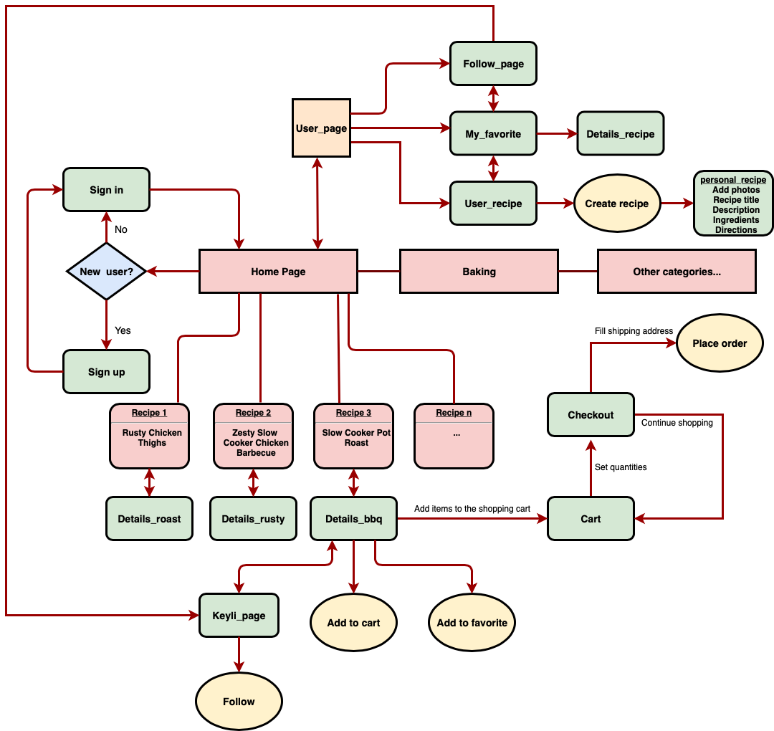
Structure Plane
Information
Architecture

Slide 3
Structure Plane
Conceptual Model
An app to share food recipients by performing various tasks such as:
Post your own blogs of recipients
Post comments like questions and answers
Follow other app users
Interact with other app users
Add the recipes you like into your favorite for quick-look next time.
One-click add all of the materials in one recipe to cart
Checkout

Slide 4
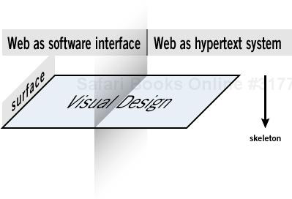
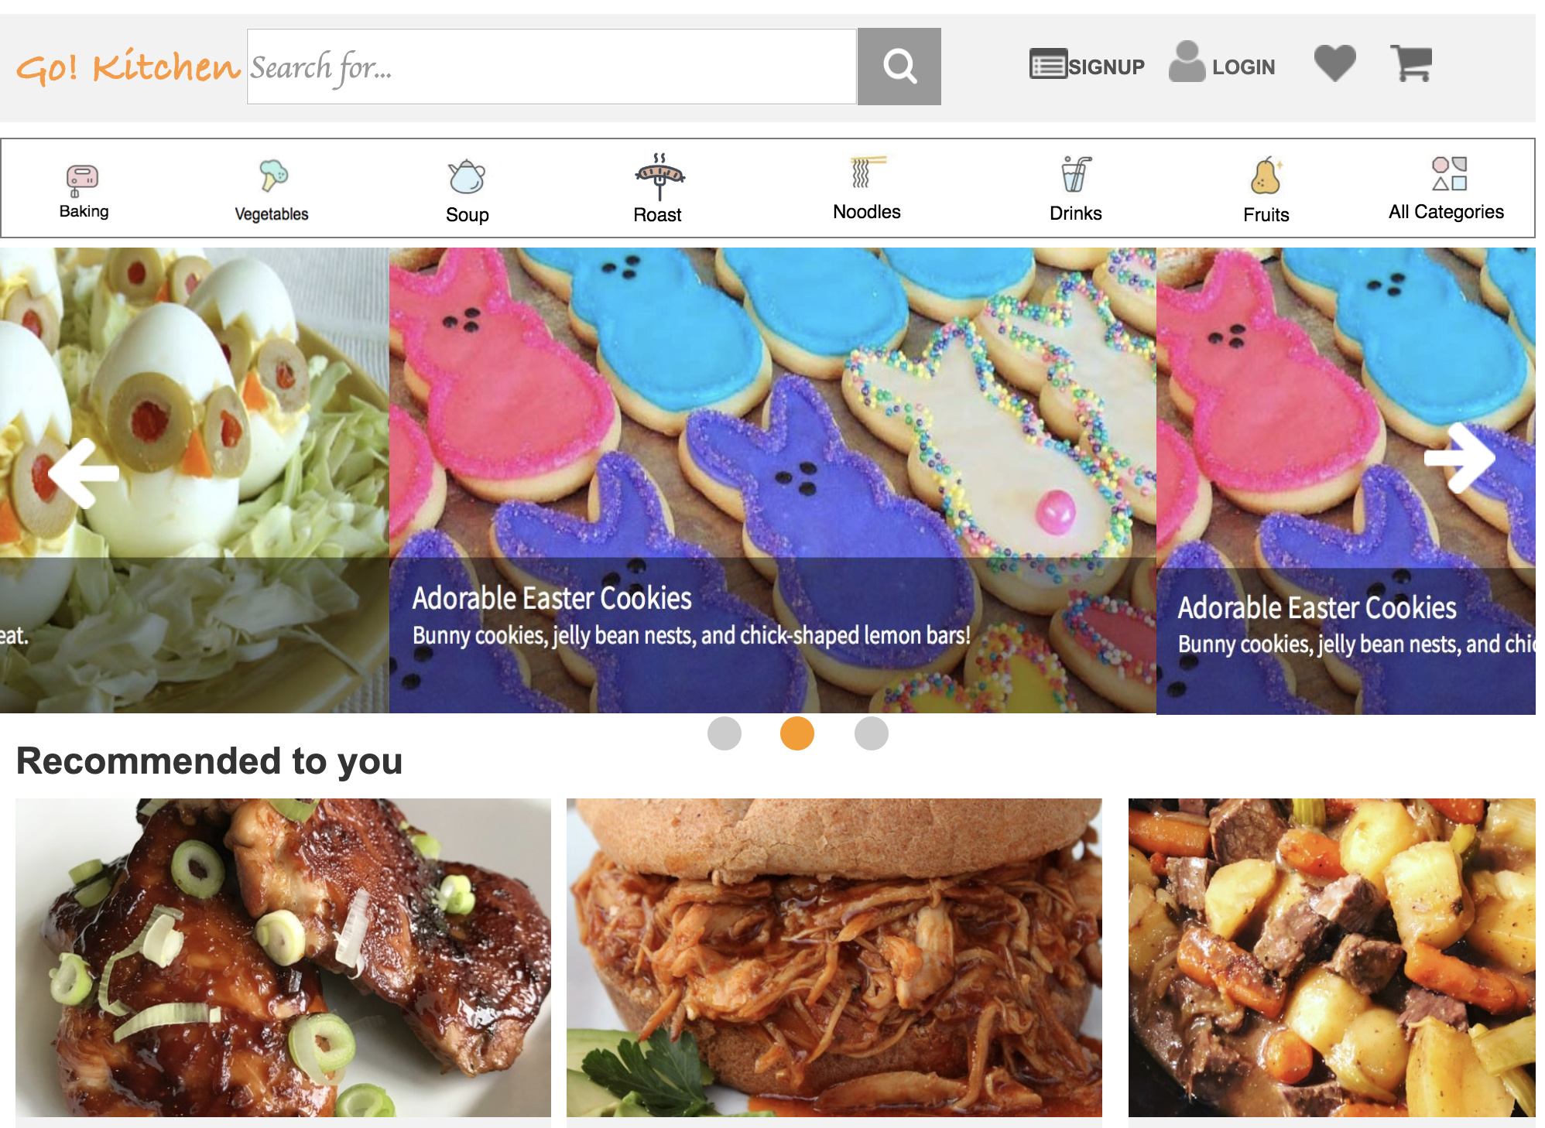
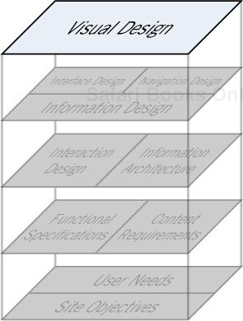
Surface Plane
Notes:
On the surface you see a series of Web pages, made up of images and text.
Some of these images are things you can click on, performing some sort of function such as taking you to a shopping cart. Some of these images are just illustrations, such as a photograph of a book cover or the logo of the site itself.

Slide 5
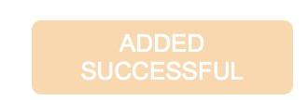

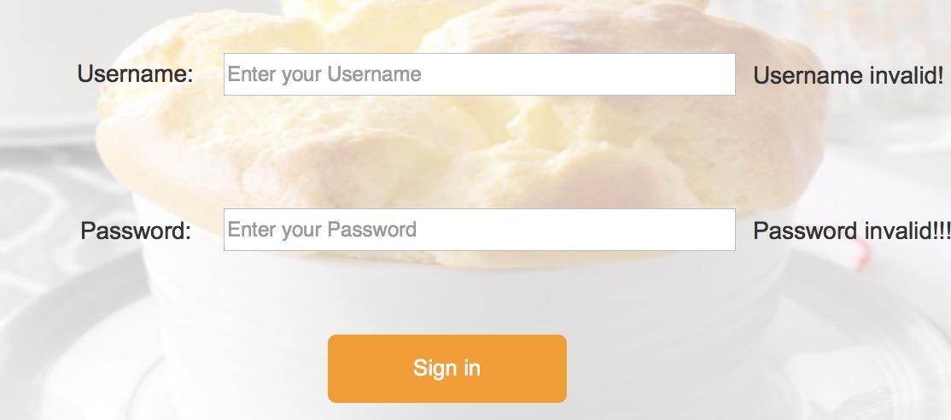
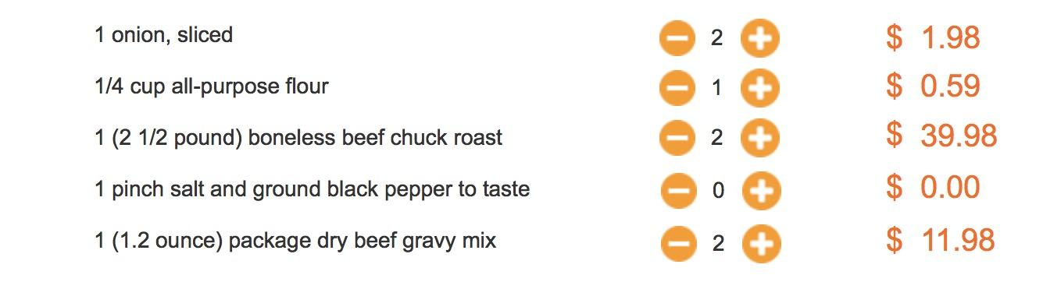

Human Computer Interaction
When clicking buttons
Form validation Automatically calculation
Notes:
For human computer interaction. It gives you response like when you’re clicking button, checkout, sign in etc

Slide 6

Google Material Design
Material is the metaphor
- It models things in the real world
- Unified theory of a rationalized space and a system of motion
- Inspired by the study of paper and ink, yet technologically advanced and open to imagination and magic
Container: Primary 1 #666666ff/100%
Text Label: On Primary 2 ##ffffffff/100%
1
2
Notes:
We followed the 3 principles of google material design, for example the colorway

Slide 7
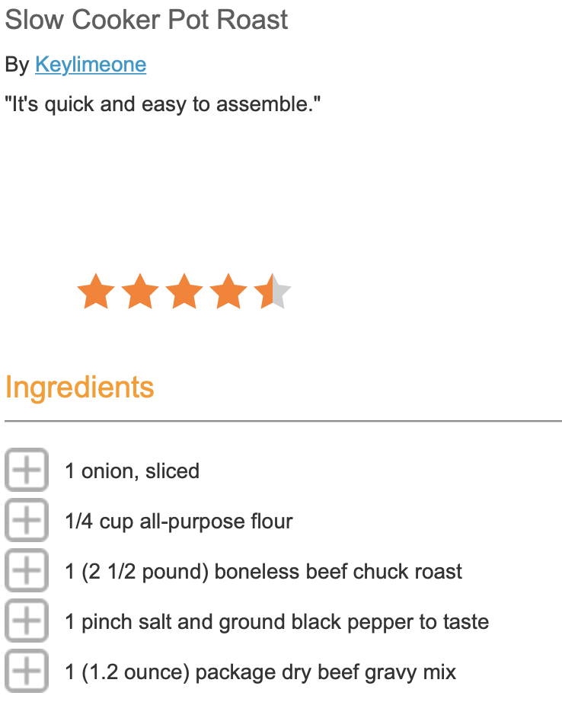
Google Material Design
Bold, graphic, intentional
- Deliberate color choices, edge-to-edge imagery, large-scale typography, and intentional white space create a bold and graphic interface that immerse the user in the experience
- An emphasis on user actions makes core functionality immediately apparent and provides waypoints for the user
Notes:
The layout

Slide 8
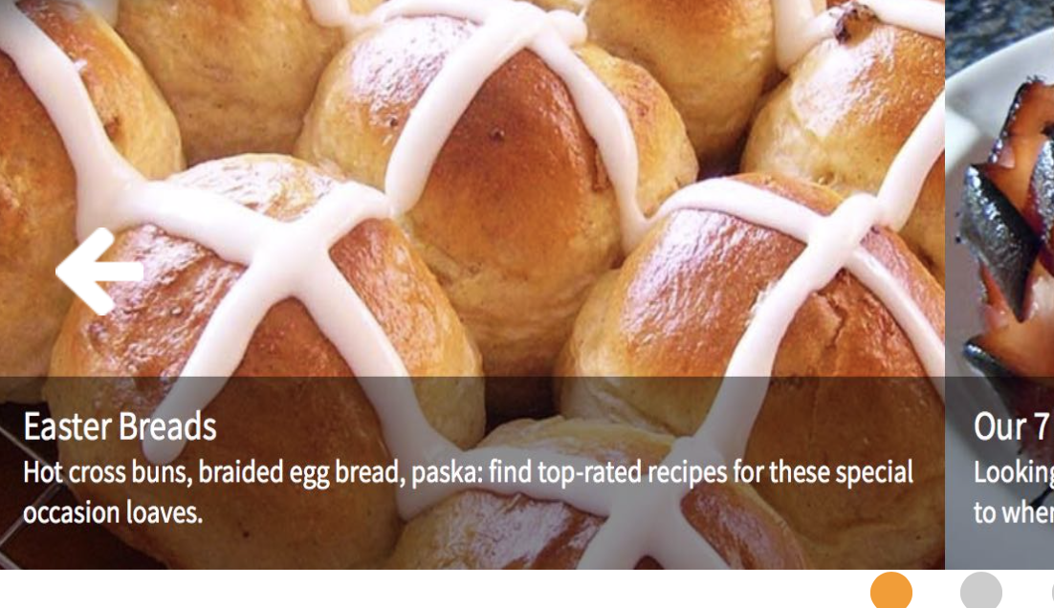
Google Material Design
Motion provides meaning
- Motion respects and reinforces the user as the prime mover
- Motion is meaningful and appropriate, serving to focus attention and maintain continuity
- Objects are presented to the user without breaking the continuity of experience even as they transform and reorganize
Notes:
The motion effects

Slide 9
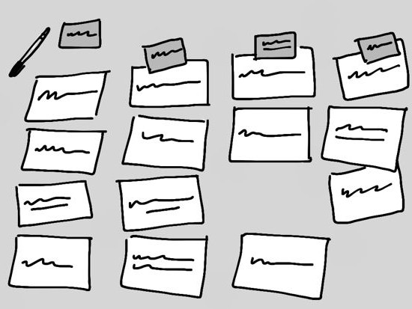
UX Methods
Technique Number 1 – Card Sorting
Simple concept：Words or phrases on cards, ask the user to categorize them.
Advantages:
Cheap form of research – particularly face-to-face;
Easy technique for users and clients to understand;
Easy method to get user input (or even to get user validation) for ideas early.
Notes:
Based on Guest speaker’s lecture, first we decided to use Card sorting to provide useful results. We’ve launched one closed card sorting test, which has 7 categories and 15 cards.

Slide 10
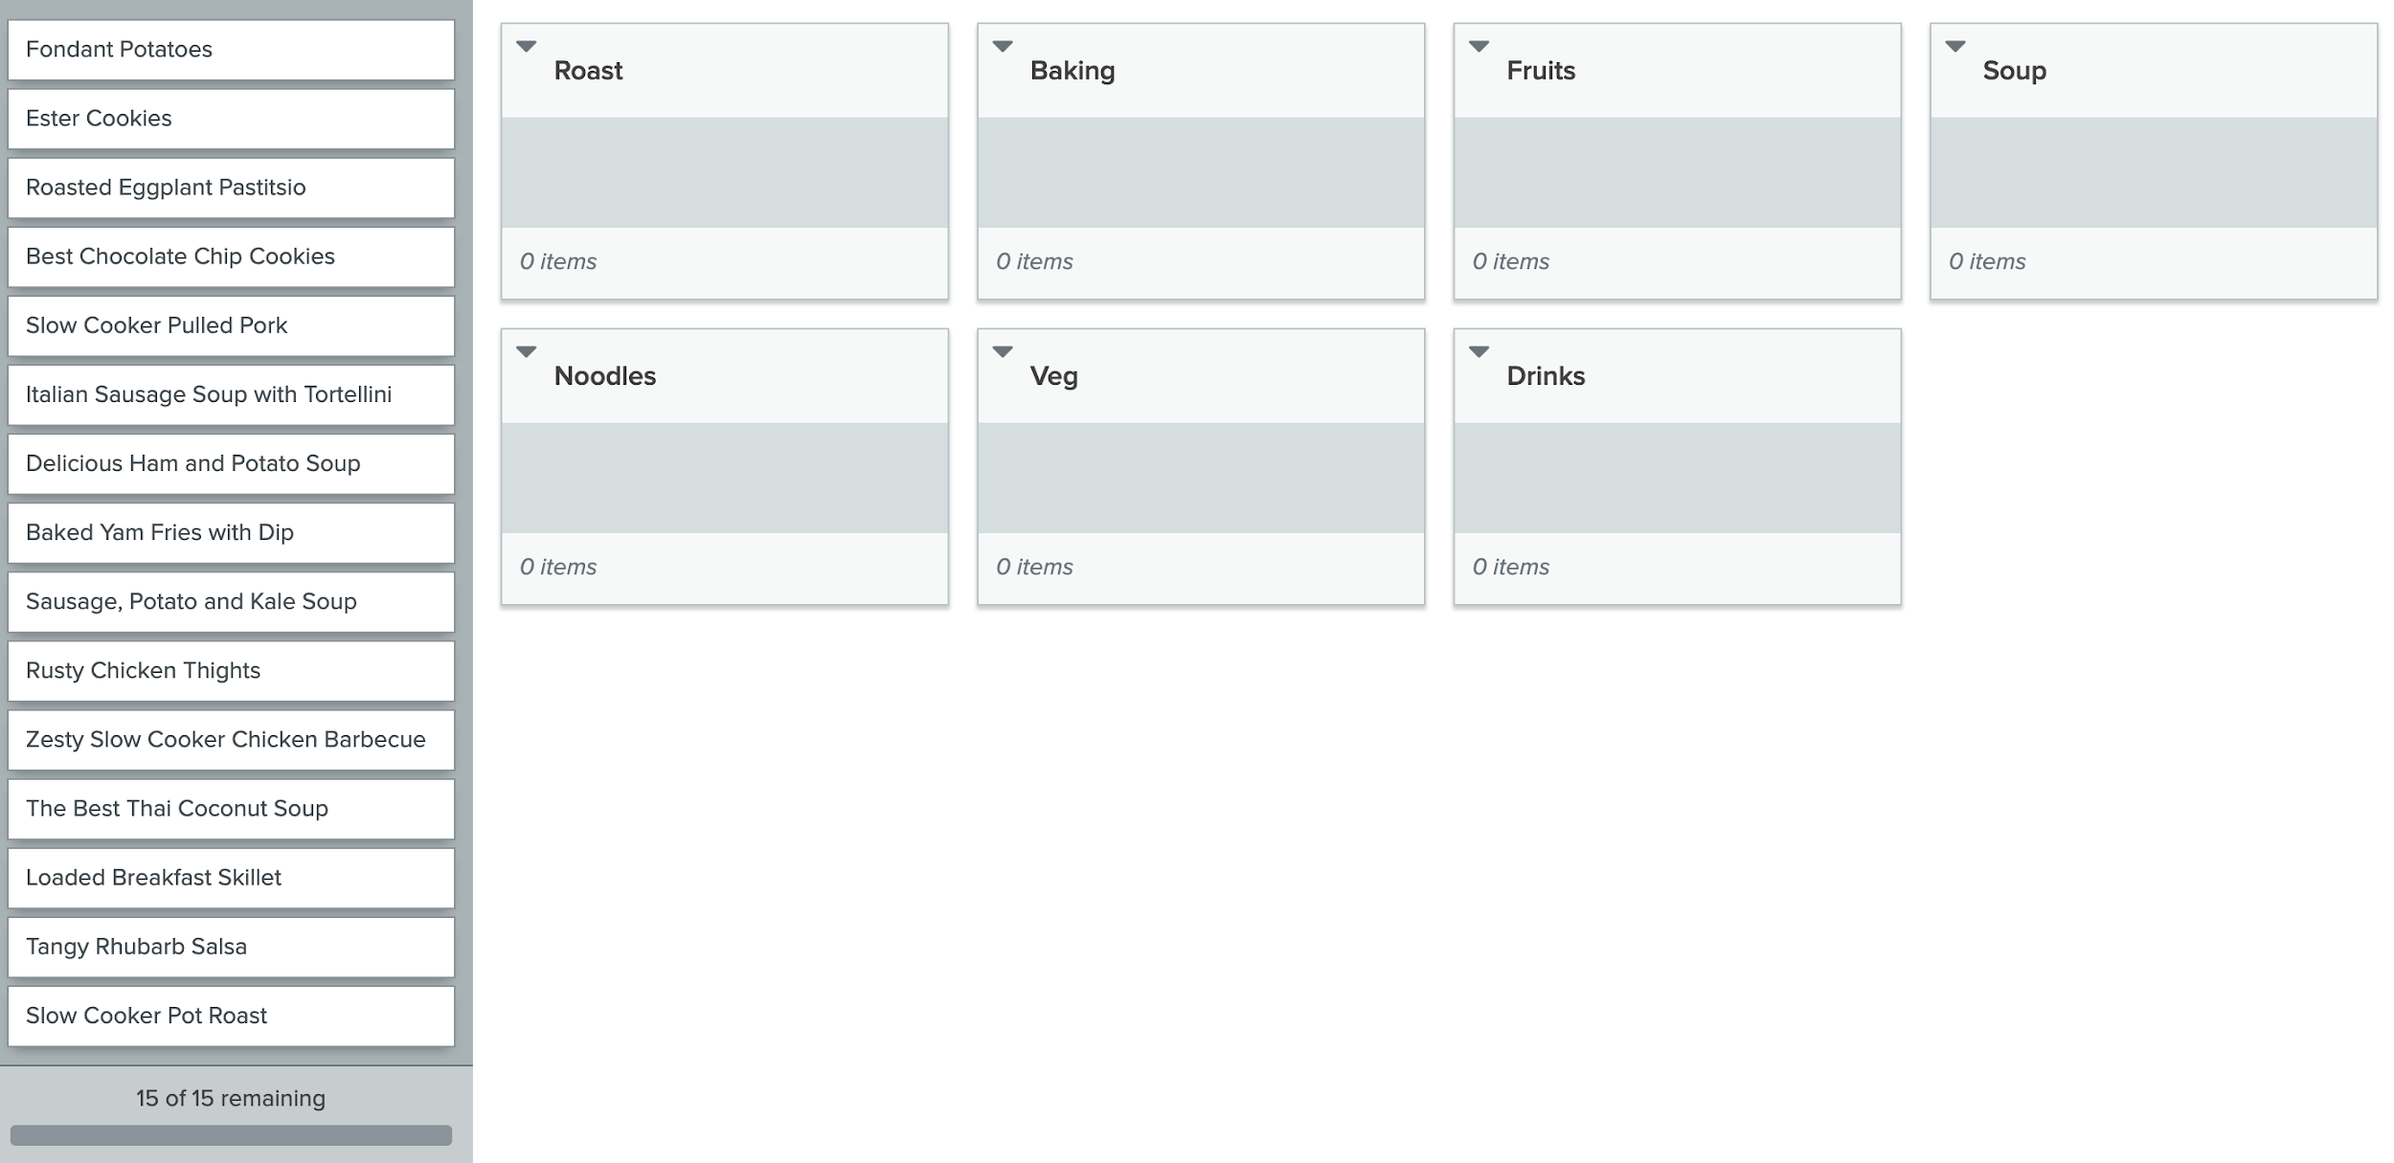
Card Sorting

Slide 11
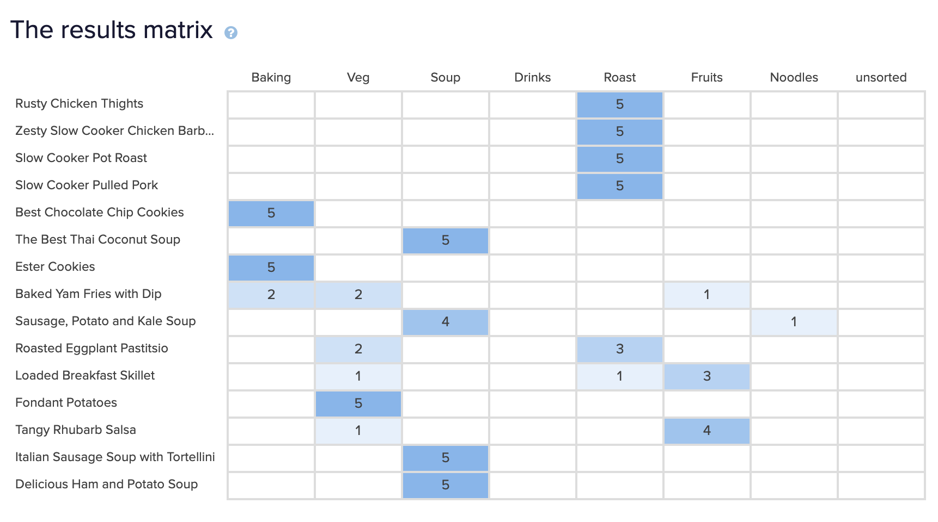
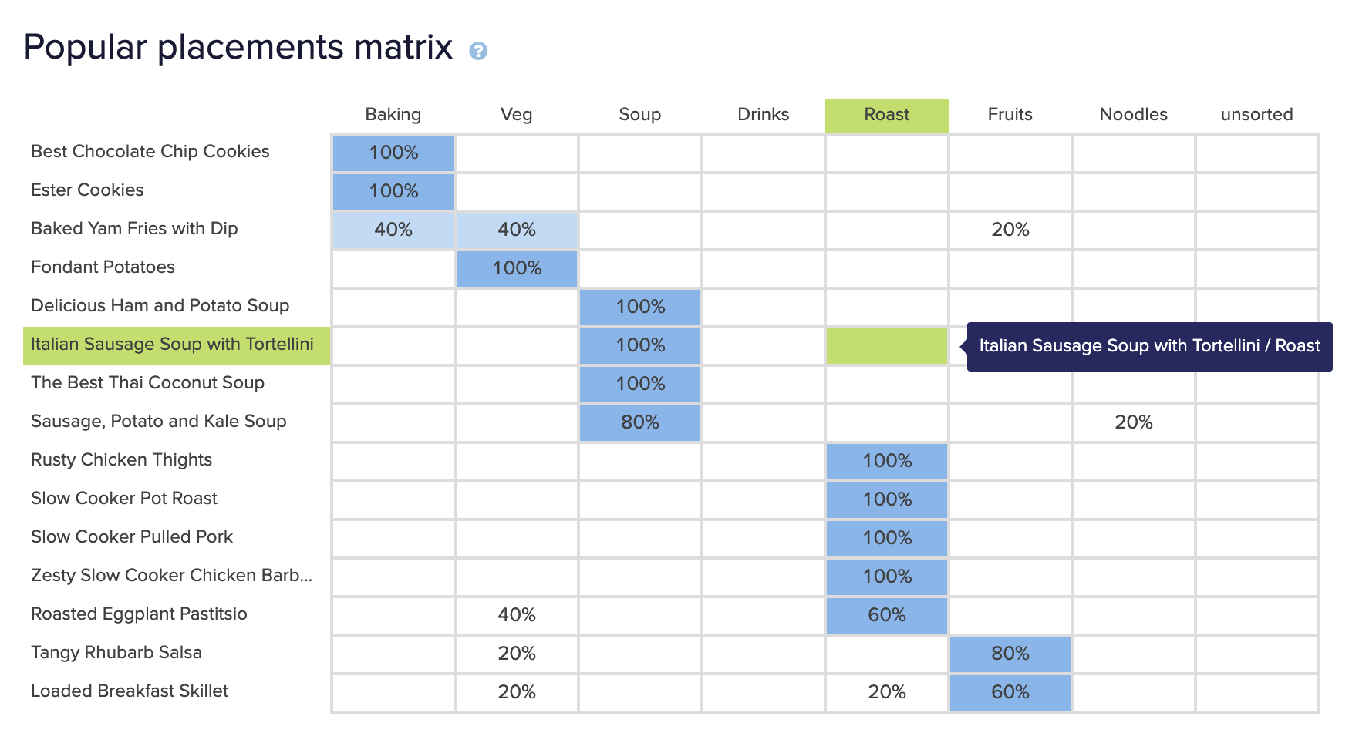
Card Sorting

Slide 12
UX Methods
Technique Number 2 – The Expert Review
A single “expert” walking through a product via the User Interface (UI) and looking for issues with the design, accessibility, and usability of the product.
Advantages:
Quick, easy and cheap;
A great way to inform further UX research and caution should be used in taking an expert review at face value without further user testing

Slide 13
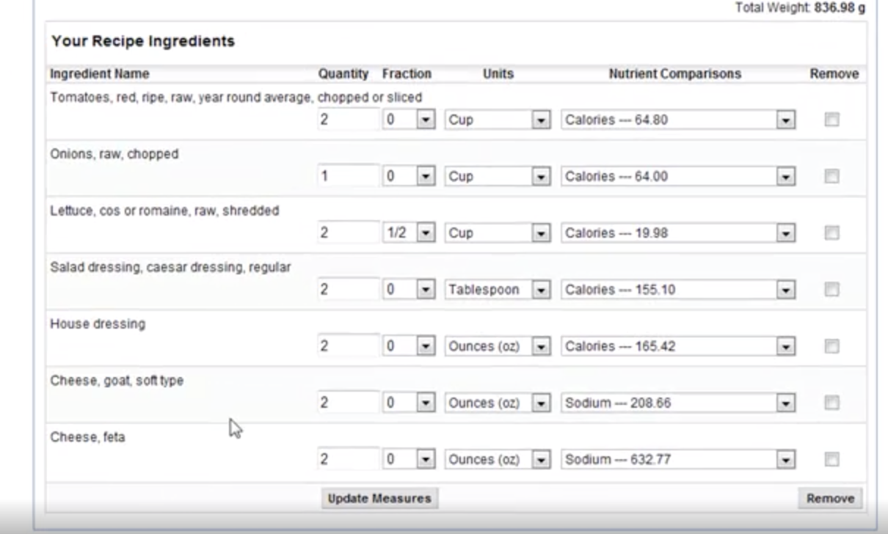
The Expert Review
One expert from MenuCalc®, who is one of dedicated recipe analysis professionals, Registered Dietitians and FDA menu labeling experts.
Detailed Recipe Analysis
Healthier Recipe Evaluation
Allergen Identification
Notes:
We are experts in crafting alternate recipes with phenomenal taste that are free from traces of: 1. Egg 2.Milk 3. Fish 4. Shellfish 5. Peanuts 6.Tree nuts 7. Soy 8. Wheat

Slide 14
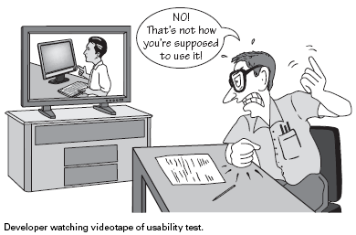
UX Methods
Technique Number 3 – Usability Testing
Usability testing is the observation of users trying to carry out tasks with a product, can focus on a single process or be much more wide ranging.
Advantages:
Pick the right users;
Produce specific results that lead to specific action;
Increases clients’ enthusiasm to show clearly why such testing adds value.
Notes:
We put the most effort on Usability testing.

Slide 15

Usability Testing
Find participants:
Filter condition: Cooker or Housekeeper; Online habits; English
Gender & age ratio: Gender: 2 males and 1 females
2. Execution test: By observing their respective use processes, recorded the following points separately
Age: 9 ~30 | 31 ~ 45 | 46~ 70
1 | 1 | 1
Notes:
In order to find the right participants, we set up three Filter conditions. The first one is Cooking habits: Participants must have at least three months of cooking habits.The second condition is Online habits especially Online shopping habits: monthly online shopping habits of at least one month or more.The last one is English:The participants must have basic English reading ability. By observing their respective use processes, we recorded the following points separately.

Slide 16
Usability Testing
Participant No.1:
Purpose | Sign up | Find Recipe
Complete or not | Yes | No
Completion path | Click SIGNUP button-> Input information-> Finish | Click roast category button-> Can’t jump to the target page
Complete time | 2 min

Slide 17
Usability Testing
Participant No.2:
Purpose | Add Recipe to Favourite | Sign In
Complete or not | Yes | Yes
Completion path | Find a food on the homepage-> Click Add button -> Add to Favourite | Click Sign In-> Type Username & Passwords-> Click Sign in
Complete time | 2 min | 1 min

Slide 18
Usability Testing
Participant No.3:
Purpose | Search Recipe | Buy food ingredients
Complete or not | No | Yes
Completion path | Type in keywords -> Search Recipes | Click Food photo on homepage -> Go to details of Slow Cooker Pot Roast-> Click Add to shopping list button-> Click Cart-> Click Check Out-> Input Address-> Check Out
Complete time |  | 5 min

Slide 19

Usability Testing
Usability analysis & Solution:
1. Usability issues:
No Recipe Details Page
Can’t Log out from pages other than the homepage
Category menu cannot jump to the specified category page

Slide 20
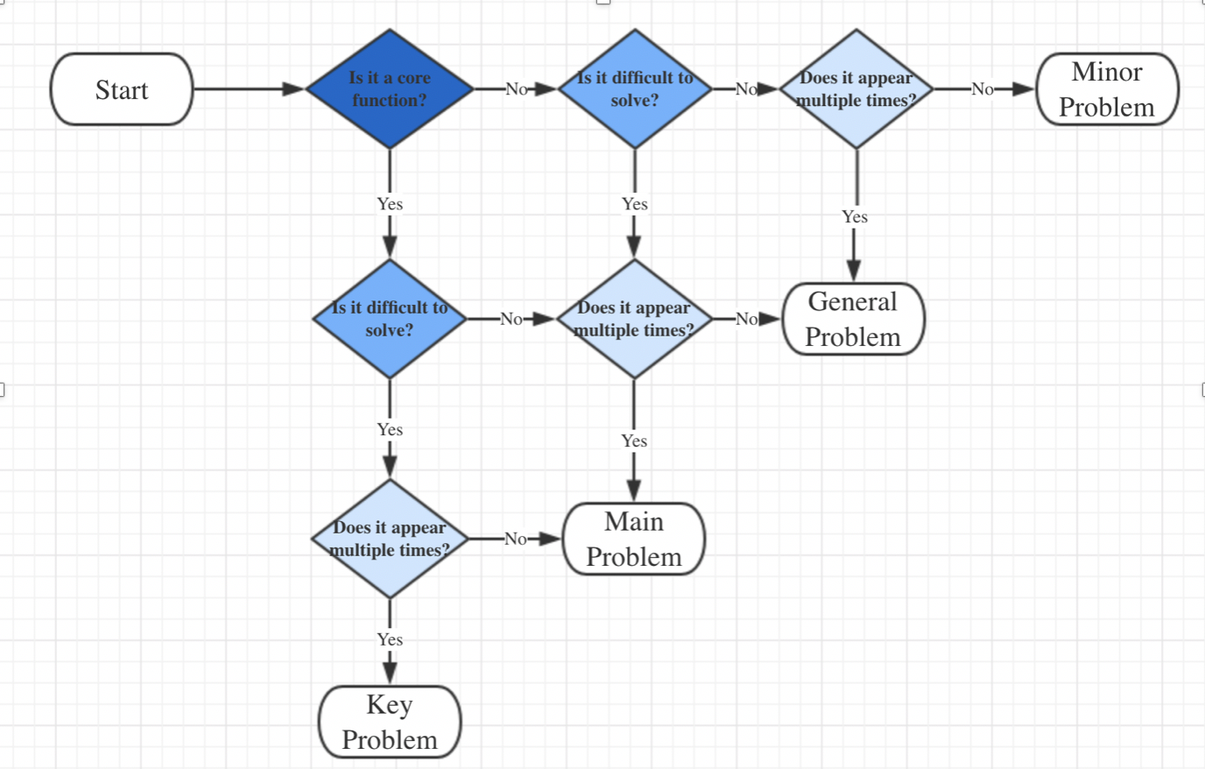
Usability Testing
2. Problem prioritization:
Following this criteria to divide the problem level.

Slide 21
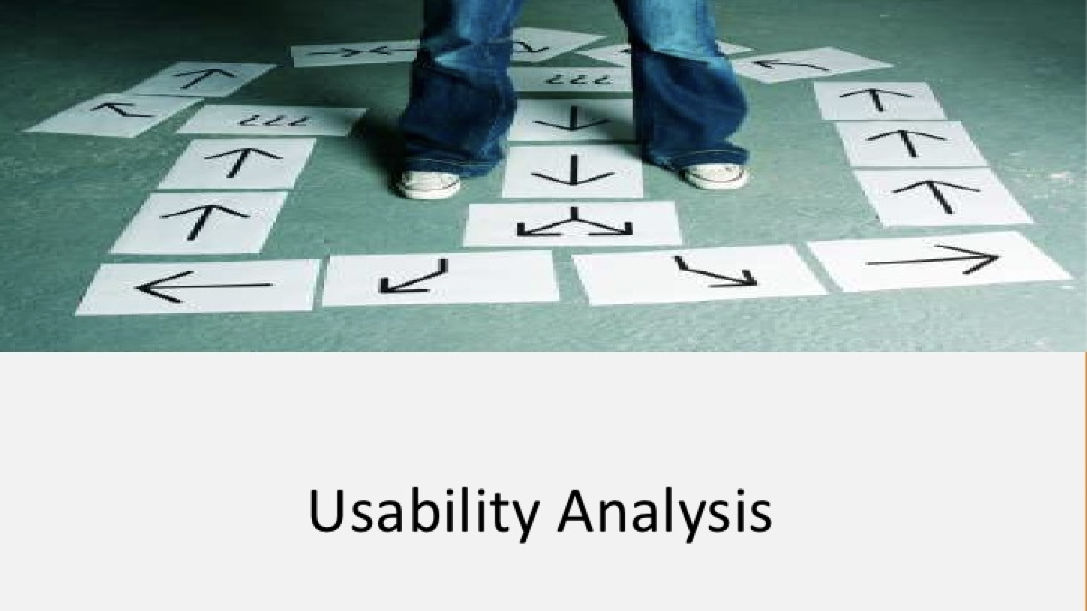
Usability Testing
3. Solution:
No Recipe Details Page | Key Problem | Design detail pages of several products.
Can’t Log out from pages other than the homepage | Minor Problem | Does not meet the usage habits of most people.
Category menu cannot jump to the specified category page | Main Problem | Because it is just a prototype design, it does not contain a back-end database. Design a prototype of one or two classification pages.

Slide 22

UX Methods
Technique Number 4 – User Personas
A fictional representation of the ideal user, focus on the goals of the user, the characteristics that they have and the attitudes that they display and examine what the user expects from the product.
Advantages:
A step above the old user profile and give a more in depth and specific;
Easy for people to relate, engage with and more memorable.

Slide 23
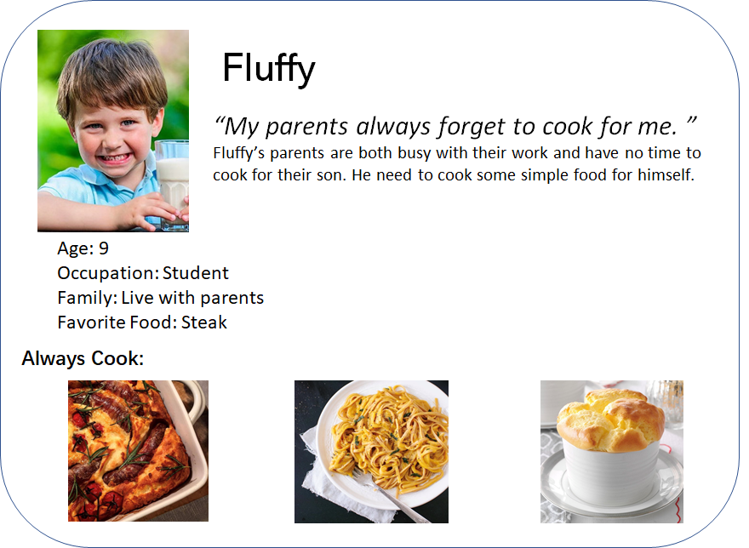
Personas

Slide 24
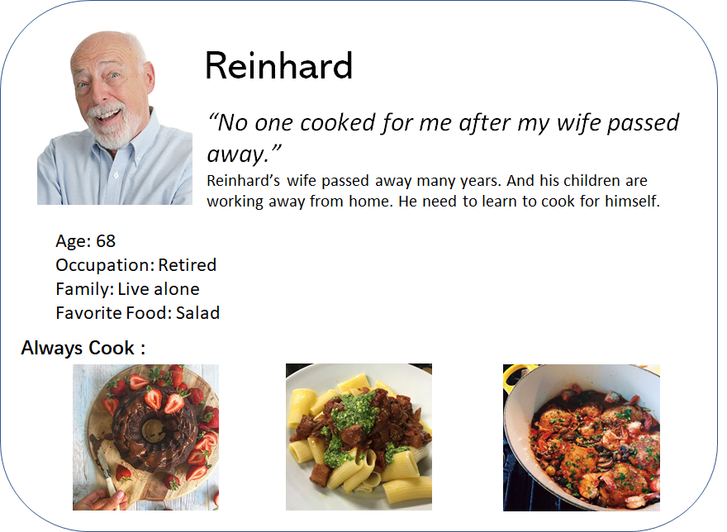
Personas

Slide 25
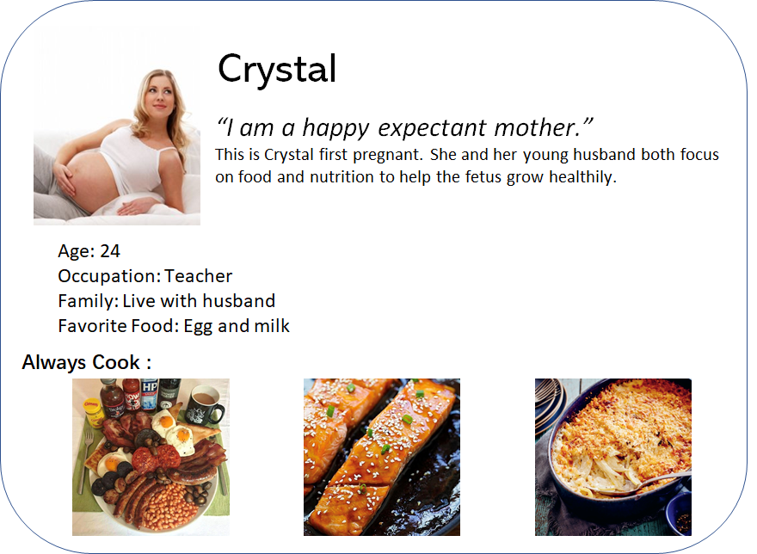
Personas

Slide 26
QA & Selenium

Slide 27
Thank You!
Q & A

